Slide 1
React Router

Slide 2
Routing is a way for navigation from one view to the next view (without leaving the page).

Slide 3
Most of the modern-day websites are Single Page Applications, or more commonly referred to as SPAs. These websites are composed of a single page but look like they span over multiple pages as a result of specific components which render like separate pages.
React Router is an external library that makes routing much easier in React applications. First, we'll install the following version of React Router:
npm install react-router-dom

Slide 4
Even though our react-driven application comprises of multiple components and we don’t necessarily display all of these components to our user.
For instance, a simple react application that contains three different components namely student component, rollno component, and subject component.
When the user clicks on a Student tab, only a student component is visible to him and the rest of the components are hidden from him and the details pertaining to a student are displayed to him. Whereas if he clicks on the roll number tab, only rollno component is visible. The same is the case for the subject component.
This is where the power of the router comes into play because without incorporating routing into our react application, this kind of navigation is not possible.

Slide 5
users always like to perform different tasks while surfing a web page.
Therefore, in this case, interactive web apps cannot be built without routing.

Slide 6
Folder Structure
To create an application with multiple page routes, let's first start with the file structure.
Within the src folder, we'll create a folder named pages with several files:
src\pages\:
Layout.js
Home.js
Blogs.js
Contact.js
NoPage.js
Each file will contain a very basic React component.

Slide 7
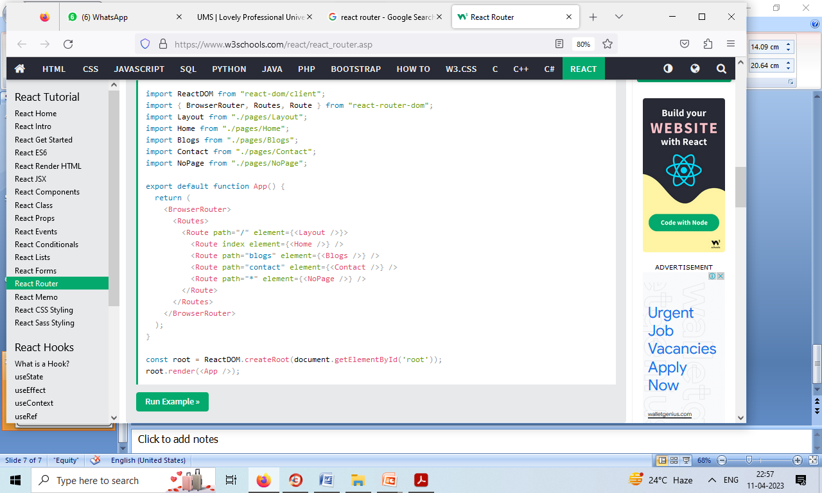
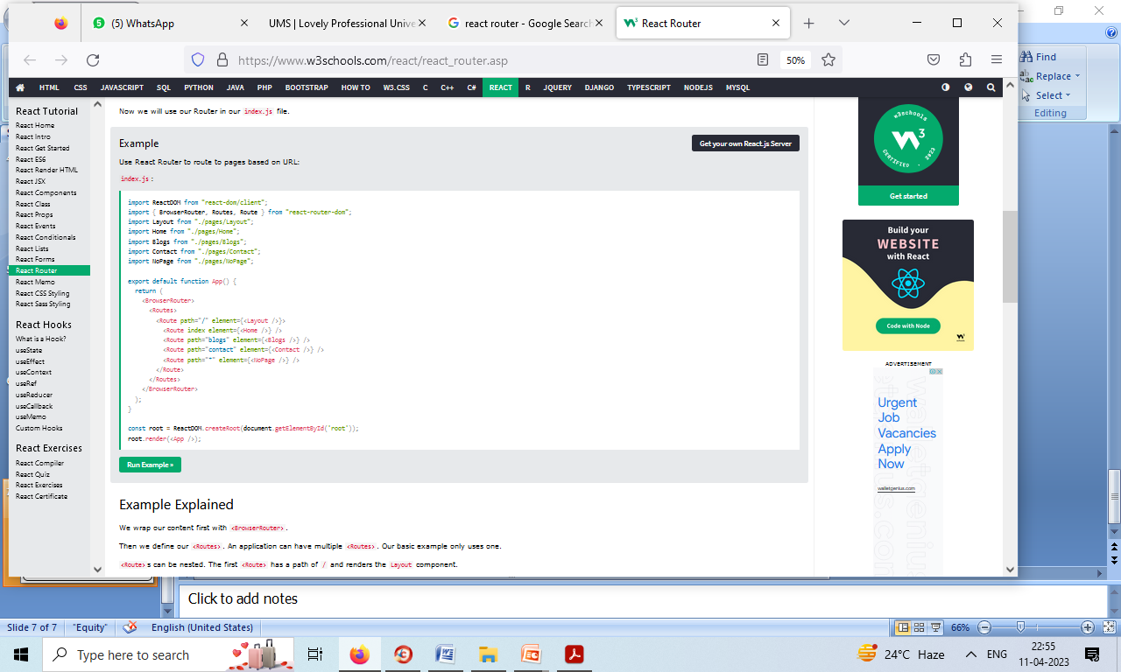
Use router in index.js- Use React Router to route to pages based on URL: in index.js do following
import ReactDOM from "react-dom/client";
import { BrowserRouter, Routes, Route } from "react-router-dom";
import Layout from "./pages/Layout"; import Home from "./pages/Home";
import Blogs from "./pages/Blogs";
import Contact from "./pages/Contact";
import NoPage from "./pages/NoPage";

Slide 8
We wrap our content first with <BrowserRouter>.
BrowserRouter is a router implementation that uses the HTML5 history API(pushState, replaceState and the popstate event) to keep your UI in sync with the URL
Then we define our <Routes>. An application can have multiple <Routes>. Our basic example only uses one.
<Route>s can be nested. The first <Route> has a path of / and renders the Layout component.
The nested <Route>s inherit and add to the parent route. So the blogs path is combined with the parent and becomes /blogs.
The Home component route does not have a path but has an index attribute. That specifies this route as the default route for the parent route, which is /.
Setting the path to * will act as a catch-all for any undefined URLs.

Slide 9
Pages / Components
The Layout component has <Outlet> and <Link> elements.
The <Outlet> renders the current route selected.
<Link> is used to set the URL and keep track of browsing history.
Link : Navigate to path
Anytime we link to an internal path, we will use <Link> instead of <a href="">.
Route : Redirect to component when path matches
The "layout route" is a shared component that inserts common content on all pages, such as a navigation menu.

Slide 10
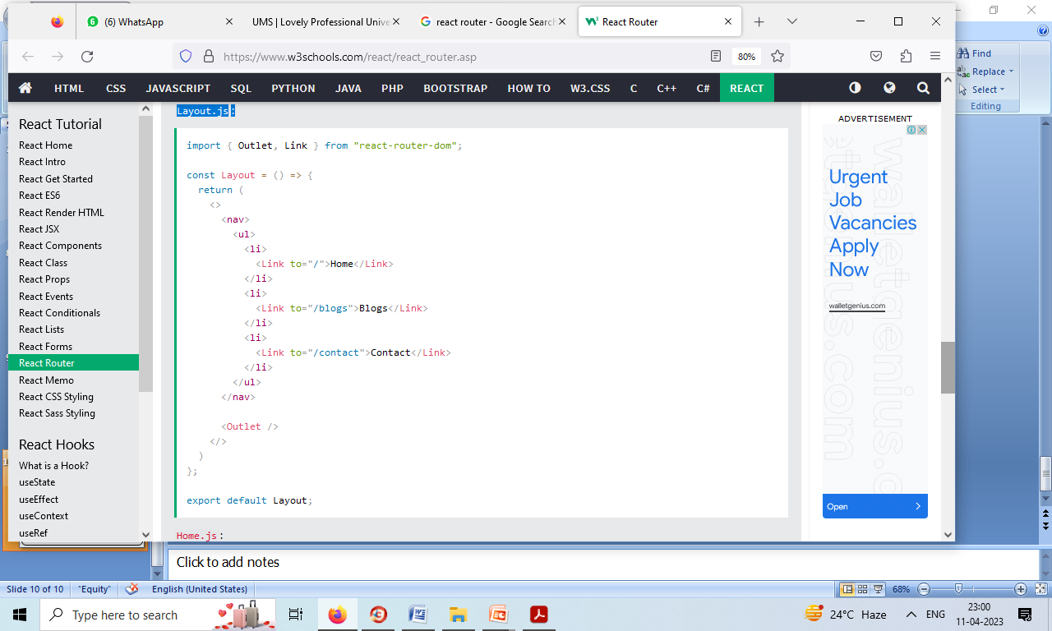
Layout.js:

Slide 11
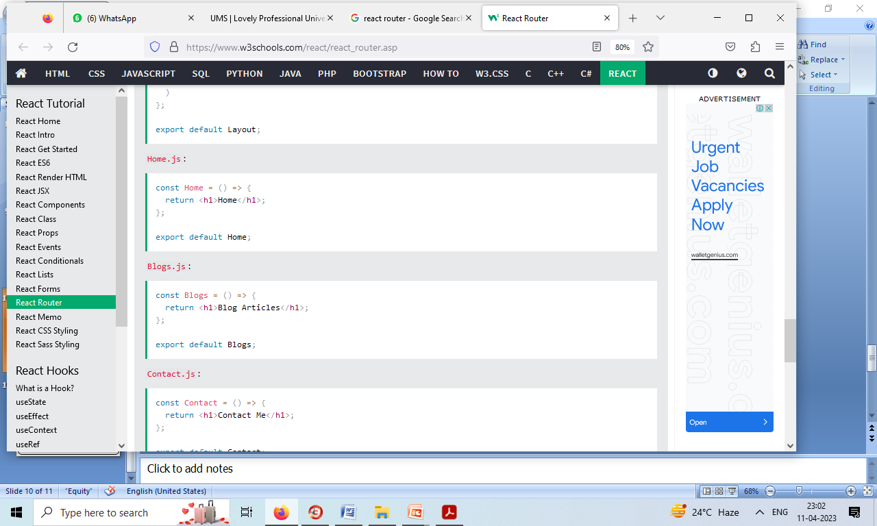

Slide 12
